Slide 1
P7: Document Clustering Summarization and Visualization
Team Members
Nagavenkata Jagan Chandanada 1224685696
Harish Paul Thavisi 1224516787
Deepthi Reddy Obulareddy Gari 1225492203
Uday Venkata Mahesh Matta 1223446549
Blessy Hadassa Konedena 1223871610
Nandakishore Narasimhamurthy 1219727158
GROUP -17

Slide 2
Problem Definition
When users search for information online, they may be presented with numerous documents that may not be directly related to their query. This can make it challenging for users to find the information they need
Clustering can help by grouping similar documents together, making it easier for users to find relevant information.
By using a search engine algorithm, clustering can limit results to only websites or documents that match the user's search category
Summarization is another useful tool that can provide a brief overview of a document, allowing users to quickly understand its contents without reading the entire text.
Summarization can be combined together with clustering for better use cases like Document organizing, Topic Extraction, Information Retrieval or Filtering
Our project can be useful in two ways
Clustering of Documents → Summarization of the Cluster Topic
Summarization of Documents → Clustering of Summaries

Slide 3
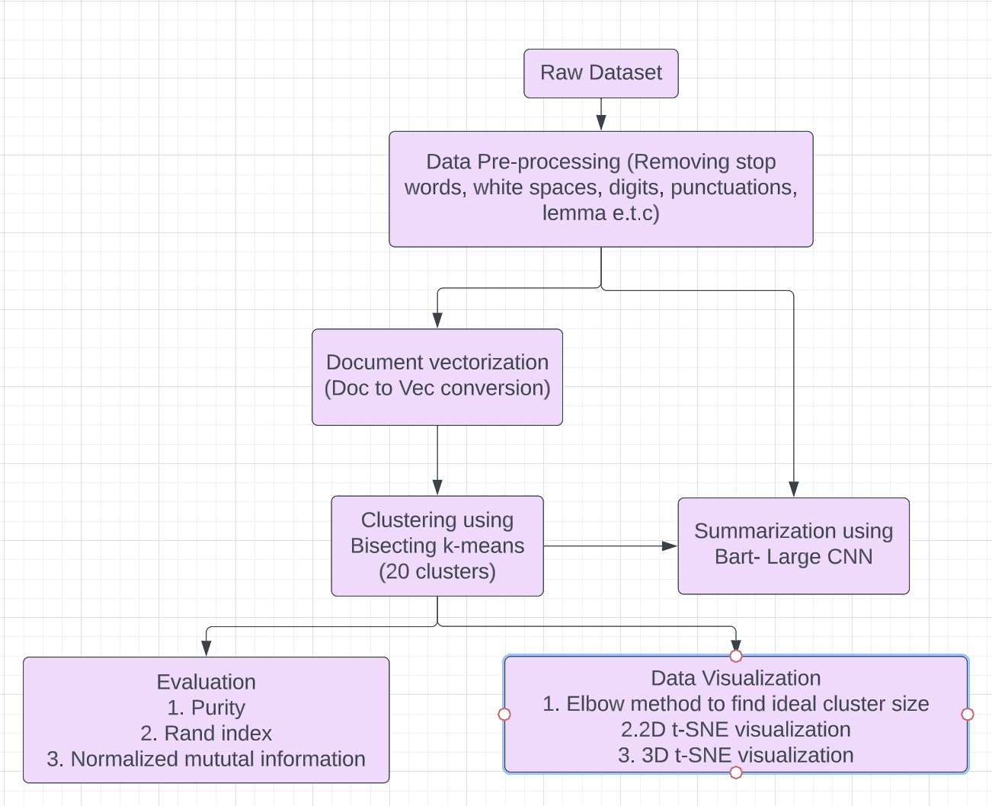
System Architecture

Slide 4
Algorithms Used
Pre-processing: After removing stop words, punctuation marks, white spaces, and digits from the given dataset, we tokenized the raw data into a set of tokens.
Document vectorization: Our next step involved converting the set of tokens into embedding vectors using Doc2Vec.
Clustering: We used a hybrid clustering model called Bisecting K-means to cluster the vectors into 20 clusters.
Summarization: To summarize the data, we used a transformer called Bart-Large-cnn on both the raw and clustered data.
Evaluation: We employed various evaluation methods such as purity, Rand Index, and Normalized Mutual Information(NMI) to assess its performance.
Data Visualization: We visualized the data using multiple techniques such as word clouds, ELBOW and t-SNE analysis of clustered data.

Slide 5
Data Set description and pre-processing
Dataset description:
Ken Lang originally collected the data set, “The 20 newsgroup dataset” .
Dataset contains 20,000 newsgroup documents which are further divided evenly across 20 different newsgroups.
The link to Dataset is http://qwone.com/~jason/20Newsgroups/
Data pre-processing:
Removed headers and footers, converting each word to lowercase.
Converting each of the words into token after removing stop words, punctuations, whitespaces.
Lemmatizing each token.
Out of 20,000 datapoints after pre-processing we are left with 18828 datapoints.

Slide 6
EVALUATION Metrics
DOCUMENT CLUSTERING EVALUATION:
Purity (A form of accuracy measure ranging from 0-1. Purity of 1 is desired.)
Normalized Mutual Information (NMI) (A Confidence measure of Clustering)
Rand Index (Builds a Confusion Matrix with equal weight to FP and FN)
DOCUMENT SUMMARIZATION EVALUATION:
Similarity Measure with SOTA Summarization Model (Distance Scores, Similarity Score. A qualitative measure of the summarization in comparison with the SOTA Models)

Slide 7
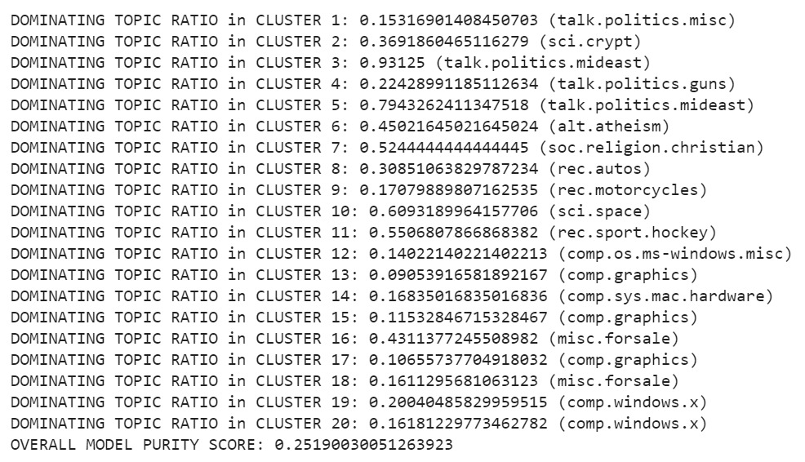
EVALUATION (Document clustering Purity)

Slide 8
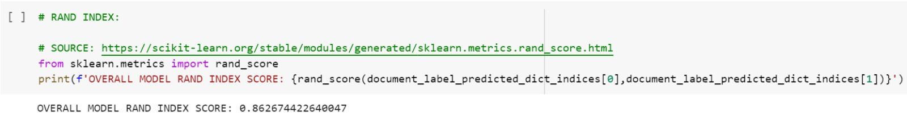
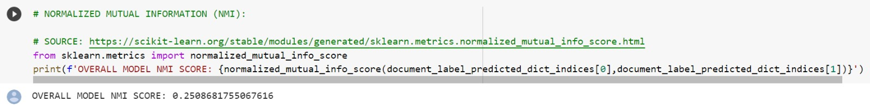
EVALUATION (Document clustering RAND Index, NMI)
Rand Index:
Normalized Mutual Information

Slide 9
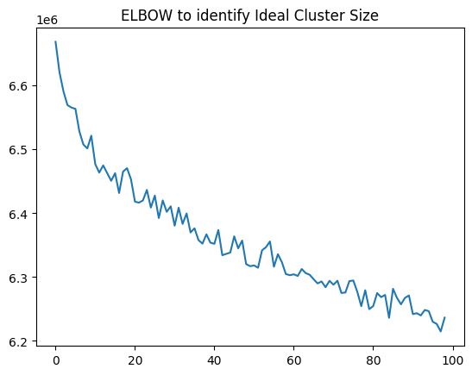
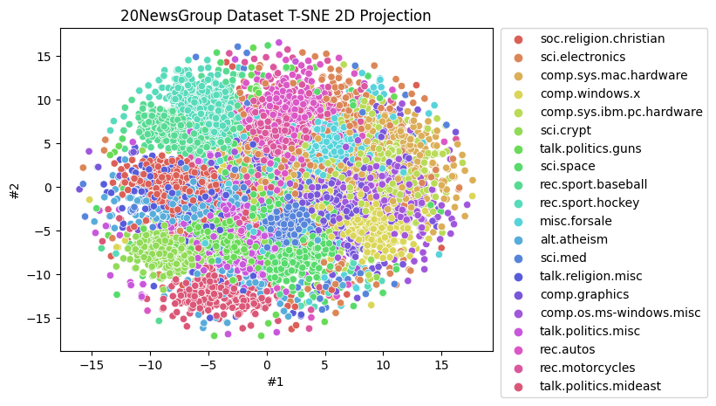
Data Visualization

Slide 10
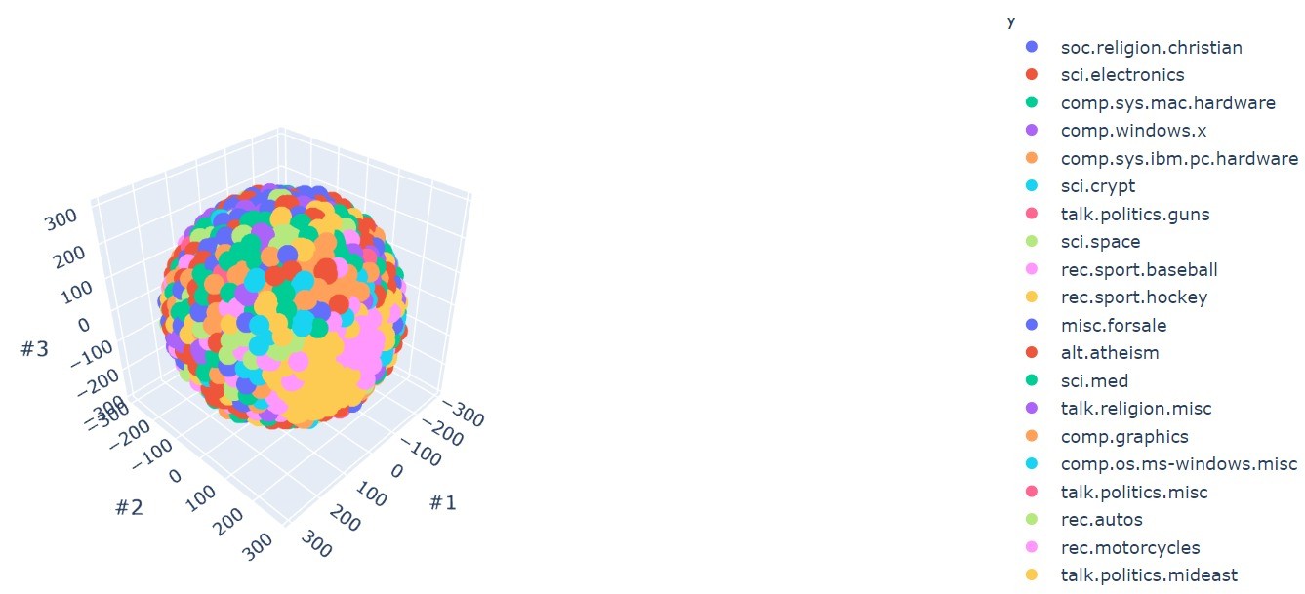
Data Visualization
20 News group Dataset T-SNE 3D projection

Slide 11
PROJECT TIMELINE
Task | Task Description | Team members | Deadline
Data Collection and Background study | Studying existing models and collecting necessary data. In addition to it, looking into various other techniques. | Everyone. | February 1st - February 15th
Data Cleaning and Pre-processing | Extracting the raw textual data, cleaning it, and preprocessing the data as per requirements | NAGAVENKATA JAGAN, NANDAKISHORE, BLESSY KONEDANA, UDAY MAHESH | February 15th - March 1st
Feature Engineering | Various sentence embeddings are generated and evaluated accordingly | HARISH PAUL THAVISI, BLESSY KONEDANA, UDAY MAHESH | March 1st - March 15th
Document Clustering | Using top2Vec to create embedded vectors and Bisecting K-Means to cluster vectors. | HARISH PAUL THAVISI, DEEPTHI REDDY, NANDAKISHORE | March 15th - March 20th
DataVisualization | UMap, and t-SNE techniques could be used to visualize high-dimensional data. | HARISH PAUL THAVISI, NAGAVENKATA JAGAN, DEEPTHI REDDY | March 20th - March 24th
Project Evaluation | Testing the clustering and summarization technique with various metrics like NMI, Rand Index | Everyone | March 1st - April 1st
Final Report | Project documentation and reporting. | Everyone | April 1st- April 25th

Slide 12
GITHUB REPO LINK
GITHUB REPO :https://github.com/jagan-chandanada/CSE573-Spring23-SWM-DocNLP

Slide 13
References
http://qwone.com/~jason/20Newsgroups/
https://towardsdatascience.com/an-introduction-to-t-sne-with-python-example-5a3a293108d1
https://www.analyticsvidhya.com/blog/2021/06/must-known-techniques-for-text-preprocessing-in-nlp/
https://en.wikipedia.org/wiki/Word2vec
https://towardsdatascience.com/bisecting-k-means-algorithm-clustering-in-machine-learning-1bd32be71c1c
https://towardsdatascience.com/extractive-summarization-using-bert-966e912f4142
https://towardsdatascience.com/understanding-automatic-text-summarization-1-extractive-methods-8eb512b21ecc
https://direct.mit.edu/coli/article/47/4/813/106774/Abstractive-Text-Summarization-Enhancing-Sequence
https://nlp.stanford.edu/IR-book/html/htmledition/evaluation-of-clustering-1.html
https://medium.com/plotly/nlp-visualisations-for-clear-immediate-insights-into-text-data-and-outputs-9ebfab168d5b
https://towardsdatascience.com/visualising-similarity-clusters-with-interactive-graphs-20a4b2a18534

Slide 14
Questions?

